Slide 1
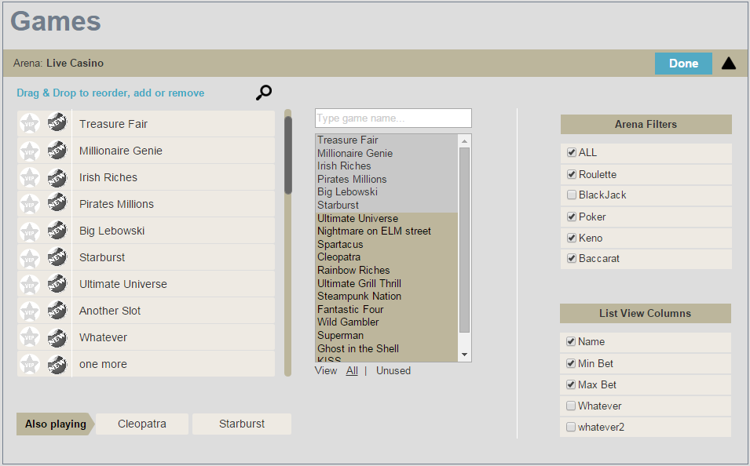
newGame issue – games_properties override the navigation_plan

Slide 2

Mobile label & vipGame
On the top right there’s a mobile labels button – if turned on, it will add the mobile label to all relevant games under that brand automatically. This is especially good for brands that do not have a mobile client, therefore we would like to remove the mobile indication off their games.
<behavior id="useMobileLogoOnIcons" value="true"/>
<game placeHolder="00" gameType="130071" templateId="btnArenaTexedTemplate" rect="MODERN_GAME_RECT" userMode="2" newGame="true"/><!--TreasureFair-->

Slide 3
Game RECT <game placeHolder="16" gameType="130005" templateId="btnArenaTexedTemplate" rect="MODERN_GAME_RECT"/> <game placeHolder="19" gameType="2310123" templateId="btnArenaTexedTemplate" rect="NETENT_GAME_RECT" /> <game placeHolder="00" gameType="130088" rect="HTML5_RECT"/> <game placeHolder="48" gameType="130044" rect="GAME_RECT_WIDE" previewTemplateId="5"/><!-- Ultimate Grill Thrills GGP --> <game placeHolder="00" gameType="2330010" rect="PLAYTECH_GAME_RECT"/><!--3D Roulette-->

Slide 4
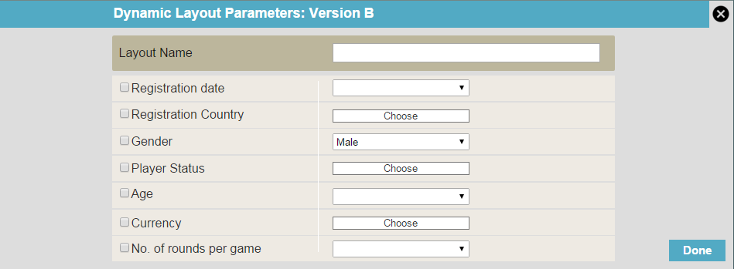
Dynamic Layout & Skin.xml
<trigger name="DynamicLayoutNew1" priority="1">
<action name="updatePlayerStatus_new1">
<conditions>
<condition updateType="multi" type="checkCountryId" equationType="equal" value="392"/> <!--japan-->
</conditions>
</action>
</trigger>

Slide 5
Default skin
Some skins don’t have their own navigation plan and they will inherit the one defined as default at the brand level. Should LayouTool have the same behavior ?
http://ndl-cdn.888.com/casino/7.2-0-60c/navigation/plan/4/navigation_plan_ndl.xmm

Slide 6
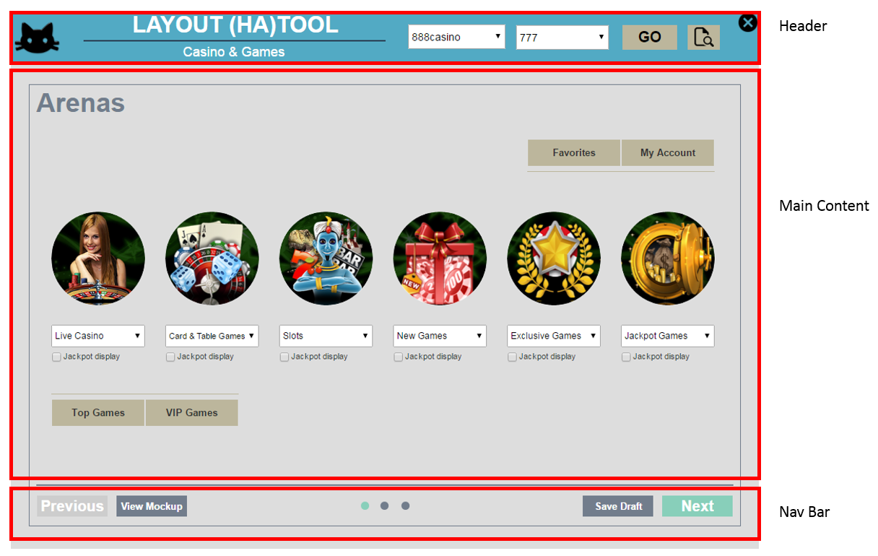
My favourites games – are actually default favourites games and are stored in the brand.xml file
<defaultFavorites>
<favorites>
<general>130008,130012,130043</general>
</favorites>
</defaultFavorites>

Slide 7
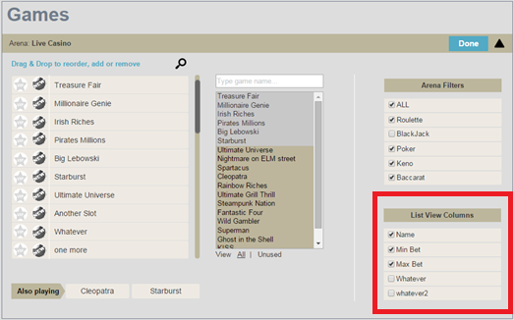
List view columns
<arenas>
<!-- CARDS AND TABLE ARENA-->
<arena type="1004" arenaLabelId="txtLineButtonCardsNTablesArena" helpLinkId="5000" favoritesSize="4" previewTemplateId="10" JPVisible="false">
<dataGridInfo>
<!-- item width="581" -->
<column label="txtDataGridGameName" field="gameTagLabelText" columnWidth="330"/>
<column label="txtDataGridMinBet" field="minBet" columnWidth="125" sortBy="minBetNumber"/>
<column label="txtDataGridMaxBet" field="maxBet" columnWidth="126" sortBy="maxBetNumber"/>
</dataGridInfo>

Slide 8
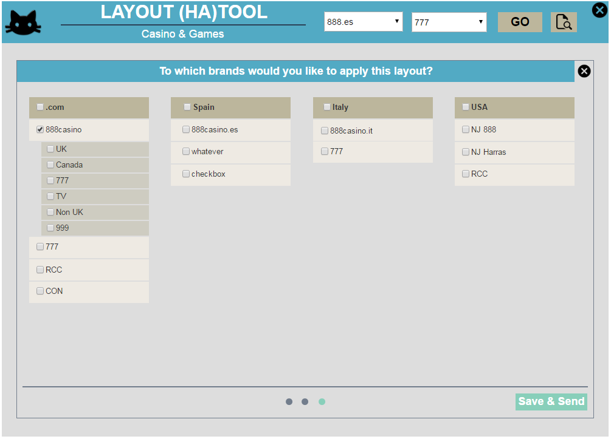
Save to any brand and skin? Just like that ?
What if not all games in the layout are in all selected brands & skins ?
What about the View Mock-up? Don’t you want to see Dynamic Layout in action ?

Slide 9
MyAccount – I need the whole list of possible items
<myAccount screen="lobby">
<itemid="MY_ACCOUNT_ITEM" onClick="MY_ACCOUNT_BTN_CLICK" iconID="myAccount" navigationLink="Account" disable="demo"/>
<itemid="MY_ACCOUNT_DEPOSIT_ITEM"onClick="MY_ACCOUNT_DEPOSIT_CLICK" iconID="myAccountDeposit"navigationLink="MyAccountDeposit"disable="demo"/>
<itemid="COMP_POINTS_ITEM" onClick="COMP_POINTS_CLICK" iconID="compPoints" navigationLink="CompPoints" disable="demo"/>
<itemid="MY_HISTORY_ITEM" onClick="MY_HISTORY_CLICK" iconID="myHistory"/>
<itemid="TRANSACTION_HISTORY_ITEM"onClick="OPEN_WEB_LINK_EVENT" iconID="deposit" navigationLink="TransactionHistory"disable="demo"/>
<item id="REALITY_CHECK_ITEM" onClick="REALITY_CHECK_CLICK" iconID="realityCheck" disable="demo" regulationIDs="255"/>
<itemid="PERSONOLISE_LOBBY_BTN_CLICK" onClick="PERSONOLISE_LOBBY_BTN_CLICK" iconID="settings" disable="demo" />
<itemid="ABOUT_ITEM" onClick="ABOUT_CLICK_EVENT" iconID="aboutUs"/>
<itemid="LOGOUT_ITEM" onClick="LOGOUT_CLICK" iconID="logout"/>
</myAccount>
<myAccount screen="history">
<itemid="COMP_POINTS_ITEM" onClick="COMP_POINTS_CLICK" iconID="compPoints" navigationLink="CompPoints" disable="demo"/>
<itemid="TRANSACTION_HISTORY_ITEM"onClick="OPEN_WEB_LINK_EVENT" iconID="deposit" navigationLink="TransactionHistory"disable="demo"/>
<itemid="ABOUT_ITEM" onClick="ABOUT_CLICK_EVENT" iconID="aboutUs"/>
<itemid="LOGOUT_ITEM" onClick="LOGOUT_CLICK" iconID="logout"/>
</myAccount>

Slide 10
5 arenas lobby: middle icon issue
The middle Icon is bigger.
The position of the arena in the lobby is given by X, Y coordinates.

